Slide 1
C programming
History of C programming
The C language was developed by Dennis Ritchie in 1970s at AT&T Bell laboratories.
Initially it was designed for programming in the operating system called UNIX.
After the advent of C, the whole UNIX is rewritten using it. Now almost the entire UNIX operating system and the tools supplied with it including the C complier itself are written in C.
The C language is derived from B language, which was written by ken Thompson at AT&T laboratories.
The B language was adopted from from a language called BCPL(Basic Combined Programming Language),which was developed by Martin Richards at Cambridge University.

Slide 2
Characteristics of C
C is a middle level language.
It has the simplicity of a high level language as well as the power of a low level language.
C language is consisting the 32 keywords.
C is a portable language.
C is a case sensitive.
In C language compilation and execution is faster.
C language is Extendible.
C is a structured language.

Slide 3
Compilation stages
Source code
Pre-processor
Expended code
Compiler
Assembly code
Assembler
Object code
Linker
Executable code

Slide 4
Preprocessor
The source code is the code which is written in a text editor and the source code file is given an extension ".c". This source code is first passed to the preprocessor, and then the preprocessor expands this code. After expanding the code, the expanded code is passed to the compiler.
Compiler
The expended code is passed to the compier. the machine converts this code into the machine’s assembly language code.
Assembler
This assembly language code is converted to object code by system,s assembler.
Linker
The linker combines this object code of the library functions with object code of our program.Therefore, we conclude that the job of the linker is to link the object code of our program with the object code of the library files and other files. The output of the linker is the executable file.

Slide 5
C Memory Layout
Higher address
Stack
Dynamic Memory
layout
Heap
Uninitialized data Segment
Static Memory
layout
Initialized data Segment
Text/Code segment
Lower address

Slide 6
Text segment
The text segment is also known as the code segment. When we compile any program, it creates an executable file like a.out, .exe, etc., that gets stored in the text or code section of the RAM memory.
Data section
The data which we use in our program will be stored in the data section. The variables declared in the data section could be stored in the form of initialized, uninitialized, and it could be local or global.
Therefore, the data section is divided into four categories, i.e.,
initialized.
uninitialized.
global.
local.

Slide 7
Example for Uninitialized and Initialized :-
#include<stdio.h>
int var1;
int var2 = 10;
void func()
{
printf("I am function");
}
int main()
{
func();
return 0;
}

Slide 8
Uninitialized data segment
The uninitialized data segment is also known as a .bss segment that stores all the uninitialized global, local and external variables.
If the global, static and external variables are not initialized, they are assigned with zero value by default.
The .bss segment stands for Block Started by symbol.
For example:-
#include<stdio.h>
char a; // uninitialized global variable..
int main()
{
static int a; // uninitialized static variable..
return 0;
}

Slide 9
Initialized data segment
An initialized data segment is also known as the data segment.
A data segment is a virtual address space of a program that contains all the global and static variables which are explicitly initialized by the programmer.
For example :-
#include<stdio.h>
char string[] = "Hello world"; // global variable stored in initialized data segment.
int main()
{
static int i = 90; // static variable stored in initialized data segment..
return 0;
}

Slide 10
Stack
When we define a function and call that function then we use the stack frame.
The variables which are declared inside the function are stored in the stack. The function arguments are also stored in the function as the arguments are also a part of the function.
The stack section plays a very important role in the memory because whenever the function is called, a new stack frame is created.
Heap
Heap memory is used for the dynamic memory allocation. Heap memory begins from the end of the uninitialized data segment and grows upwards to the higher addresses.
The malloc() and calloc() functions are used to allocate the memory in the heap.

Slide 11
printf() and scanf() in C
printf() function
The printf() function is used for output. It prints the given statement to the console.
The syntax of printf() function is given below:
printf("format string",argument_list)
The format string can be %d (integer), %c (character), %s (string), %f (float) etc.
scanf() function
The scanf() function is used for input. It reads the input data from the console.
The syntax of scanf() function is given below:
scanf("format string",argument_list);

Slide 12
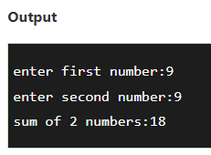
Example for printf and scanf function.
Sum of two numbers
#include<stdio.h>
int main(){
int x=0,y=0,result=0;
printf("enter first number:");
scanf("%d",&x);
printf("enter second number:");
scanf("%d",&y);
result=x+y;
printf("sum of 2 numbers:%d ",result);
return 0;
}

Slide 13
Variables in C
A variable is a name of the memory location. It is used to store data. Its value can be changed, and it can be reused many times.
Let's see the syntax to declare a variable:
type variable_list;
Example of Declaring a variable:-
int a;
float b;
char c;
We can also provide values while declaring the variables as given below:
int a=10,b=20; //declaring 2 variable of integer type
float f=20.8;
char c='A';

Slide 14
Rules for defining variables
A variable can have alphabets, digits, and underscore.
A variable name can start with the alphabet, and underscore only. It can't start with a digit.
No whitespace is allowed within the variable name.
A variable name must not be any reserved word or keyword, e.g. int, float, etc.
Types of Variables in C
1) Local Variable
A variable that is declared inside the function or block is called a local variable.
It must be declared at the start of the block.
void function1(){
int x=10;//local variable
}

Slide 15
Global Variable
A variable that is declared outside the function or block is called a global variable. Any function can change the value of the global variable. It is available to all the functions.
It must be declared at the start of the block.
int value=20; //global variable
void function1(){
int x=10; //local variable
}
Automatic Variable
All variables in C that are declared inside the block, are automatic variables by default. We can explicitly declare an automatic variable using auto keyword.
void main(){
int x=10; //local variable (also automatic)
auto int y=20; //automatic variable
}

Slide 16
Static Variable
A variable that is declared with the static keyword is called static variable.
It retains its value between multiple function calls.
void function1(){
int x=10; //local variable
static int y=10; //static variable
x=x+1;
y=y+1;
printf("%d,%d",x,y);
}
External Variable
We can share a variable in multiple C source files by using an external variable. To declare an external variable, you need to use extern keyword.
extern int x=10; //external variable (also global)

Slide 17
Data Types in C
A data type specifies the type of data that a variable can store such as integer, floating, character, etc.
There are different types of Data types.
DATA TYPES
BASIC
DERIVED
ENUMERATION
VOID

Slide 18
Types | Data Types
Basic Data Type | int, char, float, double
Derived Data Type | array, pointer, structure, union
Enumeration Data Type | enum
Void Data Type | void

Slide 19
Keywords in C
A keyword is a reserved word. You cannot use it as a variable name, constant name, etc. There are only 32 reserved words (keywords) in the C language.
A list of 32 keywords in the c language is given below:
auto | break | case | char | const | continue | default | do
double | else | enum | extern | float | for | goto | if
int | long | register | return | short | signed | sizeof | static
struct | switch | typedef | union | unsigned | void | volatile | while

Slide 20
C Identifiers
C identifiers represent the name in the C program, for example, variables, functions, arrays, structures, unions, labels, etc.
An identifier can be composed of letters such as uppercase, lowercase letters, underscore, digits, but the starting letter should be either an alphabet or an underscore.
Rules for constructing C identifiers
It should not begin with any numerical digit.
In identifiers, both uppercase and lowercase letters are distinct. Therefore, we can say that identifiers are case sensitive.
Commas or blank spaces cannot be specified within an identifier.
The length of the identifiers should not be more than 31 characters.
Identifiers should be written in such a way that it is meaningful, short, and easy to read.
some example :- total, sum, average, _m _, sum_1, etc.

Slide 21
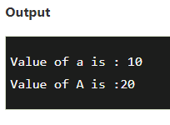
Types of identifiers
Internal identifier
If the identifier is not used in the external linkage, then it is known as an internal identifier. The internal identifiers can be local variables.
External Identifier
If the identifier is used in the external linkage, then it is known as an external identifier. The external identifiers can be function names, global variables.
int main()
{
int a=10;
int A=20;
printf("Value of a is : %d",a);
printf("\nValue of A is :%d",A);
return 0;
}

Slide 22
C Operators
An operator is simply a symbol that is used to perform operations.
Name of operators | Operators
Arithmetic operators | + , _ , * , / ,%
Increment/Decrement operators | ++ , -- ,
Relational operators | == , ! = , < = , > = , < , > ,
Logical operators | && , || , ! ,
Bitwise operators | & , ^ , | , ~ , >> , << ,
Assignment operators | = , += , - = , *= , /= , %= , <<= , >>= , &= , ^= , |= ,
Other operators | ?: & * sizeof() ,

Slide 23
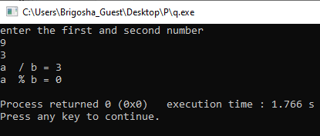
Arithmetic operator
+ , - , * , / , %
All are binary operators = means two operands are required to perform operation.
For example :- A + B
#include<stdio.h>
int main()
{
int a=9, b=3; //declaring a and b
printf(“enter the first and second number \n”);
scanf(“%d %d”, &a,&b); //accept input from the user
printf(“a / b =%d\n”, a/b);
printf(“a % b =%d\n”, a%b);
}

Slide 24
Increment/Decrement operators
++ , -- ,
Increment operator :- It is used to increment the value of a variable by one.
Decrement operator :- It is used to decrement the value of a variable by one.
Increment and Decrement operators are unary operators.Because they are applied on single operand.
Example :-
a++,a--
Increment
int a = 5;
a++;
a = 6
Decrement
int a = 5;
a--;
a = 4

Slide 25
There are two types of increment operator
Pre-increment operator Post-increment operator
++a; a++;
There are two types of decrement operator
Pre-decrement operator Post-decrement operator
--a; a--;
pre – means first increment/decrement then assign it to another variable.
post – means first assign it to another variable then increment/decrement.

Slide 26
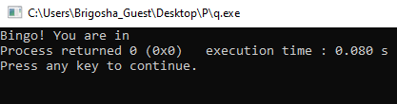
Relational operators
== , != , <= , >= , < , >
Relational operators they are used to comparing two values.
All Relational operators will return either True or False.
For example ;-
int a=300, b = 2090;
if ( b >= a )
{
printf(“Bingo! You are in”);
}
else
{
printf((“OOPS! You are out”);
}

Slide 27
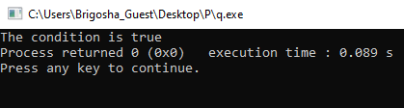
Logical operators
&& , || , ! ,
&& and || are used to combine two conditions.
&& - returns TRUE when all the conditions under consideration are true and returns FALSE when any one or more than one condition is false.
For example :
#include<stdio.h>
int main(){
int a = 5;
if(a == 5 && a != 6 && a <= 56 && a > 4)
{
printf(“The codition is true“);
}}
True=1
False=0

Slide 28
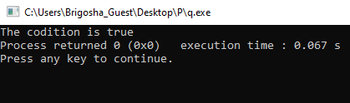
||-returns TRUE when one or more than one condition under consideration is true and returns FLASE when all conditions are false.
For example:
#include<stdio.h>
int main(){
if(a != 5 || a == 6 || a >= 56 || a > 4)
{
printf(“The codition is true“);
}
}
True=1
False=0

Slide 29
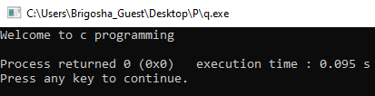
! Operator is used to complement the condition under consideration.
!-returns TRUE when condition is FLASE and returns when condition is TRUE.
For example:
#include<stdio.h>
int main()
{
int a = 5;
if(!(a == 6))
{
printf (“Welcome to this beautiful world of operators “);
}
}

Slide 30
Bitwise operators
& , ^ , | , ~ , >> , << ,
Bitwise AND (&) operator
It takes two bits at a time and perform AND operation.
AND (&) is binary operator. It takes two numbers and perform bitwise AND.
Result of AND is 1 when both bits are 1
Truth table
0 1 1 1
& 0 1 0 0
4 0 1 0 0
A | B | A&B
0 | 0 | 0
0 | 1 | 0
1 | 0 | 0
1 | 1 | 1

Slide 31
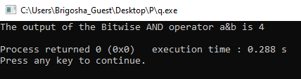
Example for bitwise AND operator :-
#include <stdio.h>
int main()
{
int a=7, b=4; // variable declarations
printf("The output of the Bitwise AND operator a&b is %d",a&b);
return 0;
}

Slide 32
Bitwise OR (|) operator
It takes two bits at a time and perform OR operation.
OR (|) is binary operator. It takes two numbers and perform bitwise OR.
Result of OR is 0 when both bits are 0
Truth table
A | B | A|B
0 | 0 | 0
0 | 1 | 1
1 | 0 | 1
1 | 1 | 1
0 1 1 1
| 0 1 0 0
7 0 1 1 1

Slide 33
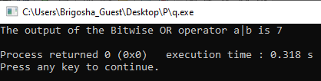
Example for bitwise OR operator :-
#include <stdio.h>
int main()
{
int a=7,b=4; // variable declarations
printf("The output of the Bitwise OR operator a|b is %d\n",a|b);
return 0;
}

Slide 34
Bitwise NOT (~) operator
NOT is a unary operator.
Its job is to complement each bit one by one.
Result of NOT is 0 when bits is 1 and 1 when bit is 0.
Truth table
A | ~A
0 | 1
1 | 0
~ 0 1 1 1
1 0 0 0

Slide 35
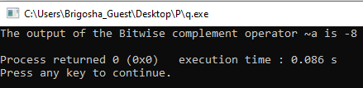
Example for bitwise NOT operator :-
#include <stdio.h>
int main()
{
int a=7; // variable declarations
printf("The output of the Bitwise complement operator ~a is %d\n",~a);
return 0;
}

Slide 36
Bitwise shift operators
Two types of bitwise shift operators exist in C programming.
The bitwise shift operators will shift the bits either on the left-side or right-side. Therefore, we can say that the bitwise shift operator is divided into two categories:
Left-shift operator
Right-shift operator
Bitwise Left shift(<<) operator
Left shift operator is binary operator and it require a two operand for perform a operation.
When bits are shifted left then trailing positions are filled with zeros.
First operand << Second operand
Whose bits get left shifted Decides the number of
places to shift the bits

Slide 37
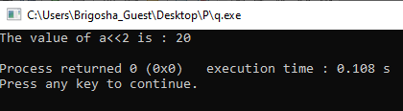
Example for bitwise Left shift operator :-
#include <stdio.h>
int main()
{
int a=5; // variable initialization
printf("The value of a<<2 is : %d ", a<<2); //0101<<2=00010100
return 0;
}

Slide 38
Bitwise Right shift(>>) operator
Right shift operator is binary operator and it require a two operand for perform a operation.
When bits are shifted left then trailing positions are filled with zeros.
First operand << Second operand
Whose bits get left shifted Decides the number of
places to shift the bits

Slide 39
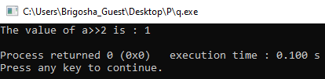
Example for bitwise Right shift operator :-
#include <stdio.h>
int main()
{
int a=7; // variable initialization
printf("The value of a>>2 is : %d ", a>>2); //0111>>2=0000 0001
return 0;
}

Slide 40
Bitwise XOR(^) operator
Bitwise XOR (^) is binary operator. It takes two numbers and perform bitwise XOR.
Result of XOR is 1 when two bits are different otherwise the result is 0.
Truth table
0 1 1 1
^ 0 1 0 0
3 0 0 1 1
A | B | A^B
0 | 0 | 0
0 | 1 | 1
1 | 0 | 1
1 | 1 | 0

Slide 41
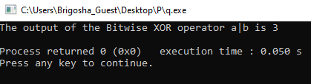
Example for bitwise XOR operator :-
#include <stdio.h>
int main()
{
int a=7,b=4; // variable declarations
printf("The output of the Bitwise XOR operator a|b is %d\n",a^b);
return 0;
}

Slide 42
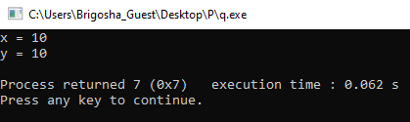
Assignment operators
= , += , - = , *= , /= , %= , <<= , >>= , &= , ^= , |= ,
Assignment operator is an operator which is used to assigned value to variable.
Assignment operator is a binary operator.
= Operator
This is a simple Assignment Operator.
For example :-
#include <stdio.h>
void main() {
int x = 10;
int y = x; // y will becomes x
printf("x = %d\n" , x); // x = ?
printf("y = %d\n" , y); // y = ?
}

Slide 43
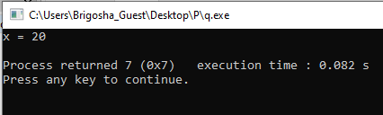
+= Operator
This is the Addition Assignment Operator.
In which the left operand becomes equal to the addition of the right operand and left operand.
For example :-
#include <stdio.h>
void main() {
int x = 10;
int y = 10;
x += y; // similar to x = x + y
printf("x = %d\n" , x); // what is x now?
}

Slide 44
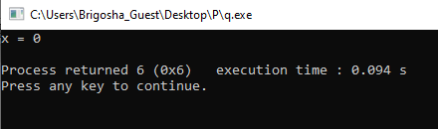
-= Operator
This is the Subtraction Assignment Operator.
In which left operand becomes equal to the subtraction of right operator from left operand.
For example :-
#include <stdio.h>
void main() {
int x = 10;
int y = 10;
x -= y; // similar to x = x - y
printf("x = %d\n" , x); // what is value of x ?
}

Slide 45
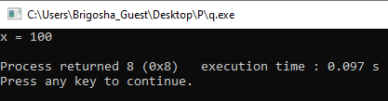
*= Operator
The main purpose of this operator is that this left operand becomes equal to the product of the left and right operand. This is the Multiplication Assignment Operator.
For example:-
#include<stdio.h>
void main(){
int x = 10;
int y = 10;
x *= y; // similar to x = x*y
printf("x = %d\n" , x); // x = ?
}

Slide 46
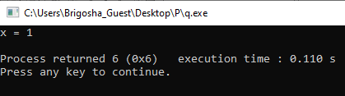
/= Operator
This one is Division Assignment Operator.
In this, the left operand becomes equal to the division of the left and right operand.
For example:-
#include <stdio.h>
void main() {
int x = 10;
int y = 10;
x /= y; // similar to x = x/y
printf("x = %d\n" , x); // x = ?
}

Slide 47
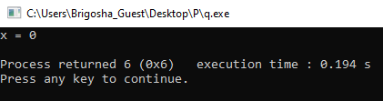
%= Operator
It is well known Modulus Assignment Operator.
In this , left operand becomes equal to the modulo of left and right operand.
For example:-
#include <stdio.h>
void main() {
int x = 10;
int y = 10;
x %= y; // similar to x = x%y
printf("x = %d\n" , x); // what is x = ?
}

Slide 48
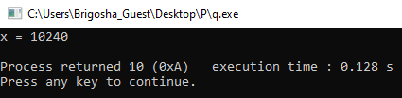
<<= Operator
This is called the Left Shift Assignment Operator.
For example x <<= y so in this, x becomes equal to x left shifted by y.
For example :-
#include <stdio.h>
void main() {
int x = 10;
int y = 10;
x <<= y; // similar to x = x << y;
printf("x = %d\n" , x); // x = ?
}

Slide 49
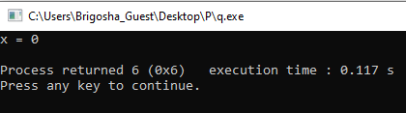
>>= Operator
This is called the Right Shift Assignment Operator.
For example x >>= y so , x becomes equal to x right shifted by y.
For example:-
#include<stdio.h>
void main(){
int x = 10;
int y = 10;
x >>= y; // similar to x = x >> y;
printf("x = %d\n" ,x); // x = ?
}

Slide 50
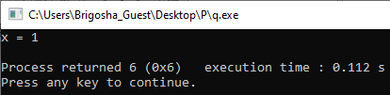
&= Operator
This operator is called the Bitwise AND Assignment Operator.
Left operand becomes equal to the bitwise AND of left and right operand.
For example:-
#include <stdio.h>
void main() {
int x = 1;
int y = 1;
x &= y; // similar to x = x & y
printf("x = %d\n" , x); // x = ?
}

Slide 51
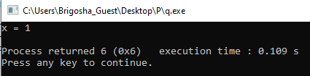
|= Operator
This is called the Bitwise Inclusive OR Assignment Operator
Left operand becomes equal to bitwise OR of left and right operand.
For example :-
#include <stdio.h>
void main() {
int x = 1;
int y = 1;
x |= y; // similar to x = x | y
printf("x = %d\n" , x); // x = ?
}

Slide 52
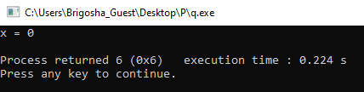
^= Operator
This is called the Bitwise Exclusive OR Assignment Operator
Left operand becomes equal to bitwise XOR of left and right operand.
For example :-
#include <stdio.h>
void main() {
int x = 1;
int y = 1;
x ^= y; // similar to x = x^y
printf("x = %d\n" , x); // x = ?
}

Slide 53
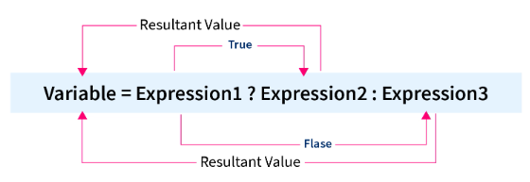
Conditional Operator in C
? :
The conditional operator is also known as a ternary operator.
The conditional statements are the decision-making statements which depends upon the output of the expression. It is represented by two symbols, i.e., '?' and ':'.
Syntax of a conditional operator :- Expression1? Expression2: Expression3;

Slide 54
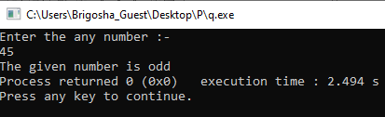
Examples of the Conditional operator in C
#include <stdio.h>
int main() {
int num;
scanf("%d", &num);
(num % 2 == 0)? printf("The given number is even") : printf("The given number is odd");
return 0;
}

Slide 55

Comma operators in C
,
To separate two or more expressions we use the comma operator in C.
Where expression1 is evaluated first, and after that expression2, and the value of expression2 is returned for the entire expression.
Comma as an Operator
When we want to assign multiple numbers of values to any variable in a program, we use the comma in the form of an operator.
#include<stdio.h>
int main()
{
int x;
int a = (x=2,x+4);
printf("%d", a);
return 0;
}

Slide 56

Comma as a Separator
The comma operator in C can be used as a separator (multiple definitions in a single line) in the program whenever we want to declare multiple variables and provide different parameters in the function.
#include <stdio.h>
int main() {
int a = 10, b = 20, c = 30;
printf("%d %d %d", a, b, c);
return 0;
}

Slide 57

Comments in C
Comments in C language are used to provide information about lines of code. It is widely used for documenting code. There are 2 types of comments in the C language.
Single Line Comments
Multi-Line Comments
Single Line Comments
Single line comments are represented by double slash \\.
For example :-
#include<stdio.h>
int main(){
//printing information
printf("Hello C");
return 0;
}

Slide 58
Multi Line Comments
Multi-Line comments are represented by slash asterisk \* ... *\. It can occupy many lines of code, but it can't be nested.
For example :-
#include<stdio.h>
int main(){
/*printing information
Multi-Line Comment*/
printf("Hello C");
return 0;
}

Slide 59
Control statements in C
The control statements in C help the computer to execute a certain logical statement and decide whether to enable the control of the flow through a certain set of statements or not.
And also these are used to direct the execution of statements under certain conditions.
Control Statements
Decision control statements.
Iterative control statements.
Jumping control statements
if
while
break
if else
for
Nested if else
do while
continue
switch

Slide 60
1.Decision Control Statements:
1.if statement:
An if statement consist of an Expression followed by one or more statements .
Flowchart:
Start
Syntax:
if (expression/Condition)
{
statements; //will execute if the expression is true.
}
Condition
True
statements
False
End
If the entered expression/Condition is validated to true, then block of code inside the if is going to execute.
If the entered expression/Condition is validated to false, then first set of code after the end of the if statement is going to execute.
The C language assumes that any non zero or non null values are true value, and if it is either zero or null then it is false value.

Slide 61
Example:
#include <stdio.h>
int main ()
{
int a = 10; // local variable definition
if( a < 20 ) // check the condition using if statement
{
printf("a is less than 20\n" ); //if condition is true then print the following
}
printf("value of a is : %d\n", a);
return 0;
}
Output:
a is less than 20
value of a is : 10

Slide 62
2.if-else statement:
In if-else statement an if statement can be followed by an optional else statement ,which executes only when the expression or condition is false.
Syntax:
Flowchart:
Start
if (expression/Condition)
{
statements; //will execute if the expression is true.
}
else
{
statements; //will execute if the expression is false.
}
Condition
True
Condition Code
if Code
False
else Code
End
If the entered expression or condition is validated to true , then the if block will be executed, otherwise the else block will be executed.

Slide 63
Example:
#include <stdio.h>
int main ()
{
int a = 100; // local variable definition
if( a < 20 ) //check the Boolean condition
{
printf("a is less than 20\n" ); //if condition is true then print the following
}
else
{
printf("a is not less than 20\n" ); //if condition is false then print the following
}
printf("value of a is : %d\n", a);
return 0;
}
Output:
a is not less than 20
value of a is : 100

Slide 64
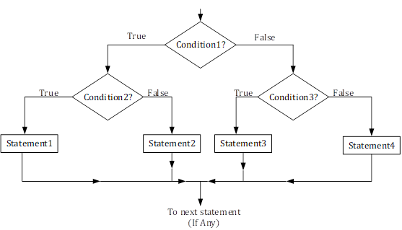
3.Nested if else statement:
The C language gives the permission to nest if-else statements, means that we can use one if or else if statement inside another if or else if statements.
Syntax:
if (expression/Condition 1)
{
if (expression/Condition 2)
{
statement 1;
}
else
{
statement 2;
}
else
{
if(condition 3)
{
statement 3;
}
else{
Statement 4;
}
}
Flowchart:

Slide 65

Example:
#include<stdio.h>
int main()
{
int num1, num2, num3;
printf("Enter three numbers:\n");
scanf("%d%d%d",&num1, &num2, &num3);
if(num1>num2)
{
if(num1>num3) //This is nested if-else
{
printf("Largest = %d", num1);
}
else
{
printf("Largest = %d", num3);
}
}
else
{
if(num2>num3) / /This is nested if-else
{
printf("Largest = %d", num2);
}
else
{
printf("Largest = %d", num3);
}
}
return(0);
}
Enter three numbers:
200
18
29
Largest = 200

Slide 66
4.switch statement:
switch statement allows a variable to be tested for equality against a list of values. Each value is called as a case, and the variable being switched on is checked for each switch case.
Syntax:
Flowchart:
switch(expression)
{
case ‘constant expression’:
statement(s);
break;
case ‘constant expression’:
statement(s);
break;
//you can have any number of cases
default :
statement(s);
}
Start
Switch expression
Case 1
True
Statement 1
False
Case 2
True
Statement 2
False
Case N
True
Statement N
False
Default statement
End

Slide 67
Rules and working of switch statement:
The expression used in switch must be an integral or enumerated type.
We can use any number of case statements within a switch. Each case is followed by the value to be compared to and a colon.
The constant expression for a case must be the same data types as the variable in the switch, and it must be constant or a literal.
In switch case when the variable is equal to a case, then statement following that case will execute until it reaches the break statement.
After break statement is reached the switch terminates and flow of control jumps to next line following the switch statements.
Not every case needs to contain a break. If no break appears, the flow of control will fall through to subsequent cases until a break is reached.
A switch statement can have an optional default case, which must appear at the end of the switch. The default case can be used for performing a task when none of the cases is true. No break is needed in the default case

Slide 68

#include <stdio.h>
int main()
{
int week; //Declare integer variable to store week number
printf("Enter day number of week (1-7): "); //Input week number from user
scanf("%d", &week);
switch(week)
{
case 1:
printf("Its Monday.\n"); //If day == 1
printf("Its a busy day.");
break;
case 2:
printf("Its Tuesday."); //If day == 2
break;
case 3:
printf("Its Wednesday."); //If day == 3
break;
case 4:
printf("Its Thursday.\n"); //If day == 4
printf("Feeling bit relaxed.");
break;
case 5:
printf("Its Friday."); //If day == 5
break;
case 6:
printf("Its Saturday.\n"); //If day == 6
printf("It is weekend.");
break;
case 7:
printf("Its Sunday.\n"); //If day == 7
printf("Hurray! Its holiday.");
break;
default:
printf("Um! Please enter day number between 1-7."); //If day 1 to 7
}
return 0;
}
Enter day number of week (1-7): 7
Its Sunday.
Hurray! Its holiday.
Enter day number of week (1-7): 4
Its Thursday.
Feeling bit relaxed.

Slide 69
2.Iterative control statements.
LOOPS in C
Loops are also called as Iterative statements.
Loops are used in c because
These provides code reusability.
Using loops we do not need to write the same code again and again.
Using loops we can traverse over the elements of data structures.(array or linked lists)
There are 3 loops in C;
1.while loop,
2.for loop.
3.do while loop.

Slide 70
1.While loop:
The while loop in C will repeatedly executes the target statement as long as the entered condition is true.
Syntax:
Flowchart:
Start
While(condition)
{
Statement(s);
}
Condition
False
True
Code block
End
Here, statement(s) may be of single statement or are of block statements. The condition may be any expression, and true is any nonzero value. The loop iterates while the condition is true.
When the condition becomes false, the program control passes to the line immediately following the loop.

Slide 71
Example:
#include <stdio.h>
int main ()
{
int a = 10; //local variable definition
while( a < 20 ) //while loop execution
{
printf("value of a: %d\n", a);
a++;
}
return 0;
}
value of a: 10
value of a: 11
value of a: 12
value of a: 13
value of a: 14
value of a: 15
value of a: 16
value of a: 17
value of a: 18
value of a: 19

Slide 72
2.for loop:
A for loop is a repetition control structure that allows you to efficiently write a loop that needs to execute a specific number of times.
Syntax:
Flowchart:
for(init ; condition ; increment)
{
statement(s);
}
Start
init
The init step is executed first, and only once. This step allows you to declare and initialize any loop control variables. You are not required to put a statement here, as long as a semicolon appears.
Next, the condition is evaluated. If it is true, the body of the loop is executed. If it is false, the body of the loop does not execute and the flow of control jumps to the next statement just after the 'for' loop.
After the body of the 'for' loop executes, the flow of control jumps back up to the increment statement. This statement allows you to update any loop control variables. This statement can be left blank, as long as a semicolon appears after the condition.
The condition is now evaluated again. If it is true, the loop executes and the process repeats itself (body of loop, then increment step, and then again condition). After the condition becomes false, the 'for' loop terminates.
Condition
False
True
Code block
increment
End

Slide 73
Example:
first 10 natural numbers are:
1
2
3
4
5
6
7
8
9
10
#include <stdio.h>
int main ()
{
int i; //local variable definition
printf("first 10 natural numbers are:\n");
for( i =1; i<=10; i++ ) //for loop execution
{
printf("%d\n",i);
}
return 0;
}

Slide 74
3.do-while loop:
In previous two loops unlike for and while loops, do while loop check the condition at the bottom of the loop.
The do-while loop is same as while loop except the fact that its guaranteed to execute at least one time.
Syntax:
Flowchart:
do
{
Statement(s);
}
while(condition);
Start
Code block
Look up to flowchart that the conditional expression appears at the end of the loop, so whatever statement or expression are present are executes once before the condition is tested.
If the conditional expression is true then the again flow control jumps to do, and executes statements until the expression becomes false.
Condition
True
False
End

Slide 75
Example:
#include<stdio.h>
int main()
{
int i=1; //local variable definition
do //do while loop execution
{
printf("%d \t",i);
i++;
}
while(i<=10);
return 0;
}
1 2 3 4 5 6 7 8 9 10

Slide 76
3.Jumping control statements:
1.break:
The break used in C has following advantages:
Whenever the break is encountered inside a loop the loop is immediately terminated and the control resumes at the next statement following the loop.
It can be used to terminate a case in the switch statement.
If suppose we are using nested loops, and the break statement will stop the execution of the innermost loop and start executing the next line of code after the block.
Flowchart:
Syntax:
Start
break;
Conditional Code
True
Condition
break
False
End

Slide 77
Example:
#include <stdio.h>
int main ()
{
int a = 10; //local variable definition
while( a < 20 ) //while loop execution
{
printf("value of a: %d\n", a);
a++;
if( a > 15)
{
break; //terminate the loop using break statement
}
}
return 0;
}
value of a: 10
value of a: 11
value of a: 12
value of a: 13
value of a: 14
value of a: 15

Slide 78
2.continue:
The continue statement in C programming works same as like the break statement. Difference is Instead of forcing termination, it forces the next iteration of the loop to take place, skips any code in between.
For the for loop, continue statement causes the conditional test and increment portions of the loop to execute.
For the while and do...while loops, continue statement causes the program control to pass to the conditional tests.
Syntax:
Flowchart:
Start
continue;
Conditional Code
True
Condition
continue
False
End

Slide 79
Example:
#include <stdio.h>
int main ()
{
int a = 10; //local variable definition
do
{ //do loop execution
if( a == 15)
{
a = a + 1; //skip the iteration
continue;
}
printf("value of a: %d\n", a);
a++;
} while( a < 20 );
return 0;
}
value of a: 10
value of a: 11
value of a: 12
value of a: 13
value of a: 14
value of a: 16
value of a: 17
value of a: 18
value of a: 19
You can see in output 15 is not printed it got skipped and further loop continued.

Slide 80
FUNCTIONS

Slide 81
Presentation Includes :
Introduction to functions
Types of C functions
Function naming rule in c
Three main parts of function
Categorized based on argument and return value
Passing arguments
Advantage of function
Recursive function
Macro’s in C

Slide 82
Introduction :
Function are used for divide a large code into module, due to this we can easily debug and maintain the code.
A function is a block of code which only runs when it is called. You can pass data, known as parameters, into a function.
Functions are used to perform certain actions, and they are important for reusing code: Define the code once, and use it many times.
Depending on whether a function is defined by the user or already included in C compilers, There Are Two Types Of Functions In C Programming
1.Standard library functions or pre-define function
2.User defined functions

Slide 83
Functions
Library Functions
User Defined Functions
Predefined
Created by user
Declarations inside header files
Reduced complexity of program
Eg: Printf () , scanf(0..etc

Slide 84
Function naming rule in c
A function name must begin with an alphabetic letter or the underscore _ character, but the other characters in the name can be chosen from the following groups:
Any lower-case letter from a to z
Any upper-case letter from A to Z
Any digit from 0 to 9
The underscore character
The general form of a function definition in C
return_data_type function_name(parameter list)
{
// body of the function
}

Slide 85
Parts of user-defined function in C
Function declaration return_Type function_Name(parameter1,parameter2,......);
function call function_Name(Argument list);
Function definition return_Type function_name(parameter_1, parameter_2,....)
{
//body of the function
}
Types of the user-defined function in C language
function with a return value and with an argument
function with a return value and without argument
function with no return value and with an argument
function with no return value and without argument

Slide 86
1.function with a return value and with an argument
#include<stdio.h>
int add( int , int ) ; //function declaration
int main( )
{
int a = 5 , b = 10 , result ;
result = add( a , b ) ; //function call and actual argument these are
printf( "%d" , result) ;
}
int add( int a , int b ) //function definition
{
int c ;
c = a + b ; //These are formal parameter
return c ;
}

Slide 87
2.function with a return value and without an argument
#include<stdio.h>
int add( ) ;
int main( )
{
int result ;
result = add( ) ;
printf( "%d" , result ) ;
}
int add( )
{
int a = 5 , b = 10 , c ; //no argument passing so declare and initilize here only
c = a + b ;
return c ;
}

Slide 88
3.function without a return value and with an argument
#include<stdio.h>
void add( int a , int b) ; //variable name is optional to written
int main( )
{
int a = 5 , b = 10 , result ;
add( a , b ) ;
}
void add( int a , int b )
{
int c ;
c = a + b ;
printf( "%d" , c ) ;
}

Slide 89
4.function without a return value and without an argument
#include<stdio.h>
void add( ) ;
int main( )
{
add( ) ; //function call
}
void add( )
{
int a = 5 , b = 10 , c ; //without return type and no argument pass
c = a + b ;
printf( "%d" , c ) ; //without return type so printf in userdefined function only
}

Slide 90
There are two methods to pass the data into the function in C language
1.Call by value
2.Call by reference.
Call by value in C
In call by value method, the value of the actual parameters is copied into the formal parameters. In other words, we can say that the value of the variable is used in the function call in the call by value method.
In call by value method, we can not modify the value of the actual parameter by the formal parameter.
In call by value, different memory is allocated for actual and formal parameters since the value of the actual parameter is copied into the formal parameter.
The actual parameter is the argument which is used in the function call whereas formal parameter is the argument which is used in the function definition.

Slide 91
Call By Value Flow Chart
Start
Read A
Read B
Swap(A,B)
Swap(int a , int b)
End
Temp =a
a=b
b=temp
Printf a
Printf b
Return

Slide 92
Swap two number using call by value
#include<stdio.h>
void swap( int , int ) ;
int main( ) {
int a = 10 , b = 20 ;
printf("before swap :a=%d\tb=%d\n",a,b);
swap( a , b ) ;
}
void swap(int a , int b)
{
int temp ;
temp = a ;
a = b ;
b = temp ;
printf("after swap:a=%d\tb=%d" , a , b ) ; }

Slide 93
Call by reference in C
In call by reference, the address of the variable is passed into the function call as the actual parameter.
The value of the actual parameters can be modified by changing the formal parameters since the address of the actual parameters is passed.
In call by reference, the memory allocation is similar for both formal parameters and actual parameters. All the operations in the function are performed on the value stored at the address of the actual parameters, and the modified value gets stored at the same address.

Slide 94
Call by referance flow chart
Start
int *p,*q
p=&a
q=&b
Read p
Read q
Swap(int *a , int *b)
Temp =a
a=b
b=temp
Swap(p,q)
End
Printf a
Print b
Return

Slide 95
Swap two number using call by referance
#include<stdio.h>
void swap( int * , int * ) ;
int main( )
{
int a = 5 , b = 10 ;
printf("before swap a=%d\tb=%d\n",a,b);
swap(&a , &b) ;
}
void swap(int *a , int *b)
{
int temp;
temp = *a ;
*a = *b ;
*b = temp ;
printf("%d\t%d\n" , &a , &b) ;
printf("after swap a=%d\tb=%d" , *a , *b) ;
}

Slide 96
Passing array as arguments in functions
#include<stdio.h>
int sum(int a[]); //function definition
int main()
{
int a[ ] = { 2 , 3 , 5 , 6 } , result ;
result = sum( a ) ; //function call
printf( "%d" , result ) ;
}
int sum( int a[ ] ) //function definition with return type and with argument
{
int sum = 0 , i ;
for(i=0 ; i<4 ; i++)
{
sum=sum + a[ i ];
}
return sum ;
}

Slide 97
Passing structure as an arguments in function
#include<stdio.h>
struct student
{
char name[ 20 ] ;
int age , per ;
} s1 ; //structure variable declaration
int main( )
{
gets(s1.name) ;
scanf( "%d %d" , &s1.age , &s1.per ) ; //age and percentage taking as input
display(s1.age , s1.per) ; //call function
}
void display( int a , int b ) //function definiion
{
printf( "age:%d\n per : %d " , a , b) ;
}

Slide 98
Passing pointer as an arguments in function
#include<stdio.h>
int main( )
{
int sallery , bonus , a ;
printf("enter sallery:") ;
scanf("%d",&sallery) ;
printf("enter bonus:") ;
scanf("%d",&bonus) ;
a = hike(&sallery,&bonus) ; //function calling
printf("total sallery:%d",a) ;
}
int hike(int *sallery , int *bonus) //with return type and with argument
{
return *sallery + *bonus ;
}

Slide 99
Passing string as an arguments in function
#include<stdio.h>
int main( )
{
char a[ 20 ] = "umesh" ;
fun( a ) ;
}
void fun(char *p)
{
printf( "%s" , p ) ;
}

Slide 100
Advantages of Using Functions in C Programming
It will reduce the time complexity
One of the primary achievements of the C functions is reusability.
we can call a function any place in program
can easily correct or debug the program
We can perform the tracking of a large C program pretty easily if we divide it into various functions.

Slide 101
Recursion and Macros

Slide 102
Introduction
Recursion is the process which comes into existence when a function calls a copy of itself to work on a smaller problem. Any function which calls itself is called recursive function, and such function calls are called recursive calls.
Recursion involves several numbers of recursive calls. However, it is important to impose a termination condition of recursion.
Recursion cannot be applied to all the problem, but it is more useful for the tasks that can be defined in terms of similar subtasks. For Example, recursion may be applied to sorting, searching, and traversal problems.

Slide 103
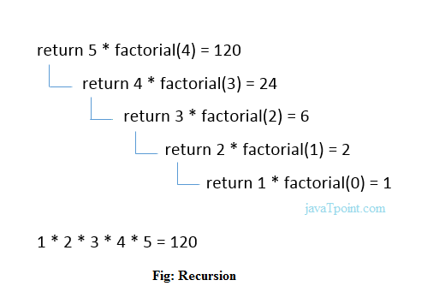
Example 1:
Calculate the factorial of a number using recursion
#include <stdio.h>
int fact (int);
int main()
{
int n,f;
printf("Enter the number whose factorial you want to calculate?");
scanf("%d",&n);
f = fact(n);
printf("factorial = %d",f);
}
int fact(int n)
{
if (n==0)
{
return 0;
}
else if ( n == 1)
{
return 1;
}
else
{
return n*fact(n-1);
}
}

Slide 104
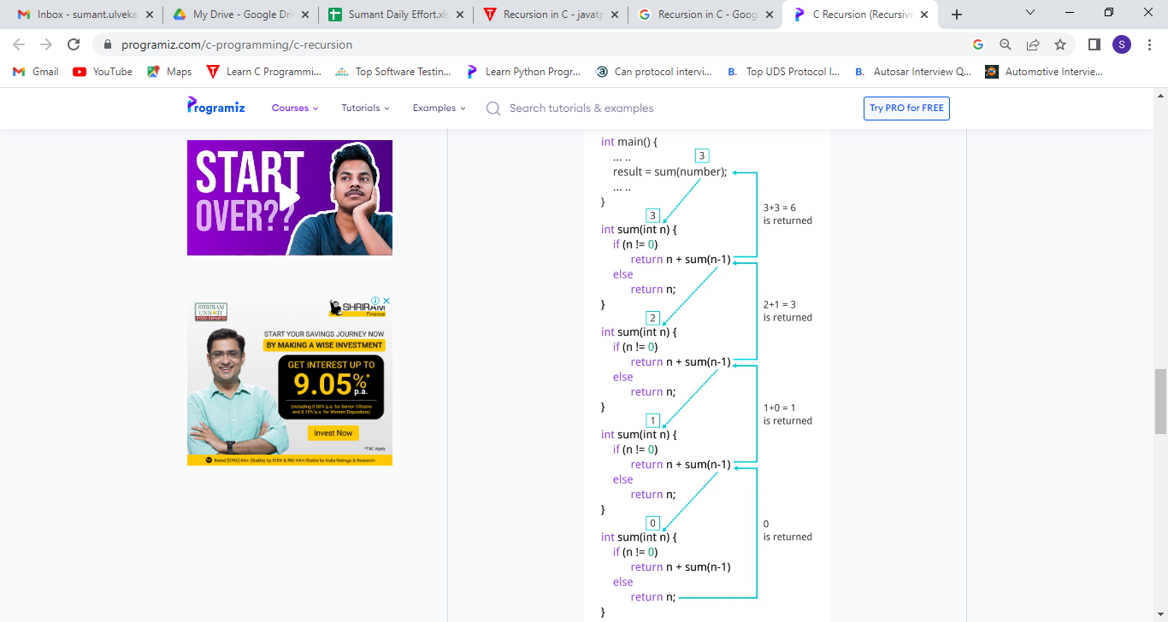
Example 2
Sum of Natural Numbers Using Recursion
#include <stdio.h>
int sum(int n);
int main( )
{
int number, result ;
printf("Enter a positive integer :");
scanf("%d", &number) ;
result = sum(number) ;
printf("sum = %d", result) ;
return 0 ;
}
int sum(int n)
{
if (n != 0)
// sum() function calls itself
return n + sum(n-1) ;
else
return n ;
}

Slide 105
Types of the recursion
1.Direct Recursion
When a function calls itself within the same function repeatedly, it is called the direct recursion.
fun( )
{
// write some code
fun( );
// some code
}

Slide 106
Example
#include<stdio.h>
int fibo_num (int i)
{
if ( i == 0)
{
return 0; // if the num i is equal to 0, return 0;
}
if ( i == 1)
{
return 1;
}
return fibo_num (i - 1) + fibonacci (i -2);
}
int main ( )
{
int i;
for ( i = 0; i < 10; i++) // use for loop to get the first 10 fibonacci series
{
printf (" %d \t ", fibo_num (i) ) ;
}
return 0;
}

Slide 107
2.Indirect Recursion
When a function is mutually called by another function in a circular manner, the function is called an indirect recursion function.
fun1()
{
// write some code
fun2()
}
fun2()
{
// write some code
fun3()
// write some code
}
fun3()
{
// write some code
fun1()
}

Slide 108
Example
#include <stdio.h>
// declaration of the odd and even() function
void odd(); // Add 1 when the function is odd()
void even(); // Subtract 1 when the function is even
int num = 1; // global variable
void odd ()
{
// if statement check and execute the block till n is less than equal to 10
if (num <= 10)
{
printf (" %d ", num + 1); // print a number by adding 1
num++; // increment by 1
even(); // invoke the even function
}
return;
}
void even ()
{
// if block check the condition that n is less than equal to 10
if ( num <= 10)
{
printf (" %d ", num - 1); // print a number by subtracting 1
num++;
odd(); // call the odd() function
}
return;
}
int main ()
{
odd(); // main call the odd() function at once
return 0;
}

Slide 109
3.Tail Recursion
A recursive function is called the tail-recursive if the function makes recursive calling itself, and that recursive call is the last statement executes by the function. After that, there is no function or statement is left to call the recursive function.

Slide 110
Example
#include <stdio.h>
void fun1( int num) // function definition
{
if (num = = 0) // if block check the condition
return;
else
printf ("\n Number is: %d", num); // print the number
return fun1 (num - 1); // recursive call at the end in the fun() function
}
int main ()
{
fun1(7); // pass 7 as integer argument
return 0;
}

Slide 111
4.Non-Tail / Head Recursion
A function is called the non-tail or head recursive if a function makes a recursive call itself, the recursive call will be the first statement in the function. It means there should be no statement or operation is called before the recursive calls.
Furthermore, the head recursive does not perform any operation at the time of recursive calling. Instead, all operations are done at the return time.

Slide 112
Example
#include <stdio.h>
void head_fun (int num)
{
if ( num > 0 )
{
// Here the head_fun() is the first statement to be called
head_fun (num -1);
printf (" %d", num);
}
}
int main ()
{
int a = 5;
printf (" Use of Non-Tail/Head Recursive function \n");
head_fun (a); // function calling
return 0;
}

Slide 113
C Macros
A macro is a segment of code which is replaced by the value of macro. Macro is defined by #define directive.
There are two types of macros:
Object-like Macros
Function-like Macros

Slide 114
1.Object-like Macros
The object-like macro is an identifier that is replaced by value. It is widely used to represent numeric constants.
For example: #define PI 3.14
Here, PI is the macro name which will be replaced by the value 3.14.

Slide 115
Example
#include <stdio.h>
#define SIDE 4
int main() {
int area;
area = SIDE*SIDE;
printf("Object Like Macros!\n");
printf("Area is: %d",area);
return 0;
}

Slide 116
2.Function-like Macros
The function-like macro looks like function call. For example:
#define MIN(a,b) ((a)<(b)?(a):(b))
Here, MIN is the macro name.

Slide 117
Example
#include <stdio.h>
#define AREA(s) (s * s) // macro with argument
int main()
{
int s1 = 10, area_of_square;
area_of_square = AREA(s1);
printf("Macros with arguments!\n");
printf("Area of square is: %d", area_of_square);
return 0;
}

Slide 118
C Predefined Macros
No. | Macro | Description
1 | _DATE_ | represents current date in "MMM DD YYYY" format.
2 | _TIME_ | represents current time in "HH:MM:SS" format.
3 | _FILE_ | represents current file name.
4 | _LINE_ | represents current line number.
5 | _STDC_ | It is defined as 1 when compiler complies with the ANSI standard.

Slide 119
Example
#include<stdio.h>
int main( )
{
printf("File :%s\n", __FILE__ ) ;
printf("Date :%s\n", __DATE__ ) ;
printf("Time :%s\n", __TIME__ ) ;
printf("Line :%d\n", __LINE__ ) ;
printf("STDC :%d\n", __STDC__ ) ;
return 0;
}

Slide 120
THANK YOU . . !

